Slide 1
Serving
with the
Right Heart
Michael Carter
Kairos Inside, Indiana
Fay Jones
Kairos Inside, North Carolina
Notes:
Michael/Fay

Slide 2
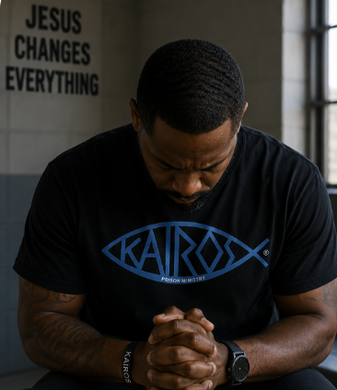
Prayer
Notes:
Michael

Slide 3
Devotion
But Jesus called them to him and said, “You know that the rulers of the Gentiles lord it over them, and their great ones exercise authority over them. It shall not be so among you. But whoever would be great among you must be your servant, and whoever would be first among you must be your slave, even as the Son of Man came not to be served but to serve, and to give his life as a ransom for many.”
- Matthew 20:25-28 (ESV)
Notes:
Michael

Slide 4
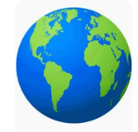
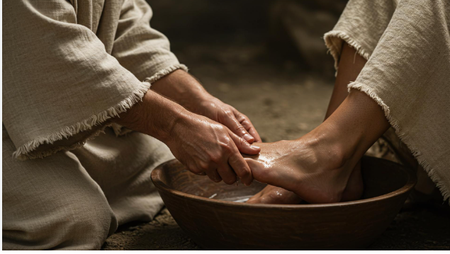
Jesus Completely Redefines Greatness
          The World Says:
          Be noticed
          Be important
          Be recognized
          Jesus says:
          Serve
          Humble yourself
          Put others first
Notes:
Michael

Slide 5
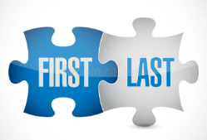
Jesus Completely Redefines Greatness
          Not about power, but purpose
          Not about status, but sacrifice
          Not about being first, but about being last
Notes:
Michael

Slide 6
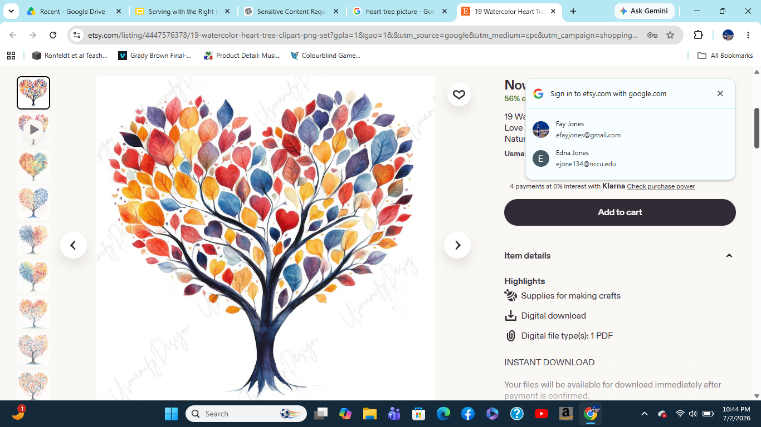
Workshop Description
Effective Kairos ministry begins with the right heart - one that is rooted in Christ, shaped by humility, and committed to serving others with His love and grace.
Notes:
Michael

Slide 7
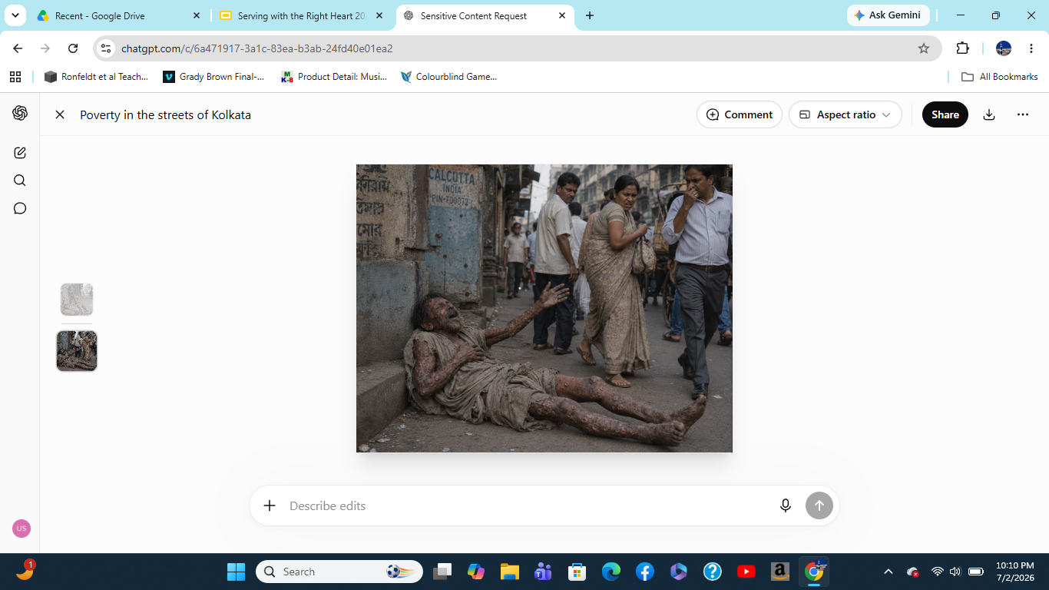
Notes:
Fay

Slide 8
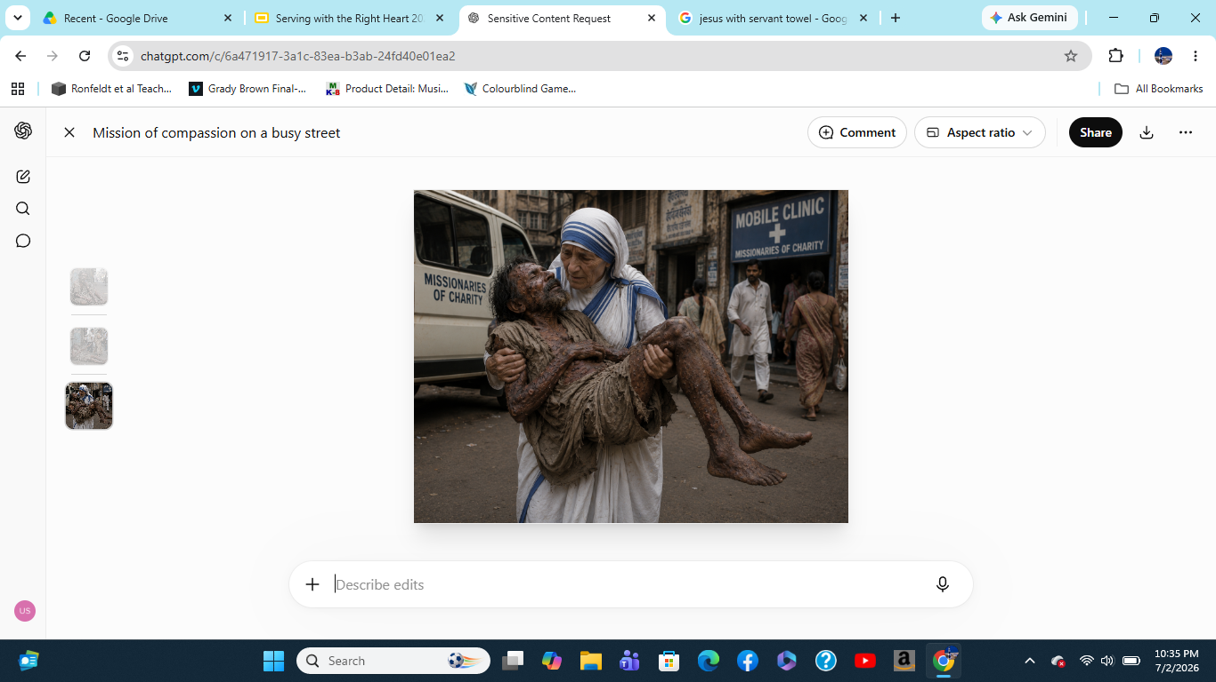
Notes:
Fay

Slide 9
Applicable Lessons
She led through action, not position.
She saw dignity where others saw discomfort.
She inspired through example.
She valued small acts deeply.
Notes:
Fay

Slide 10
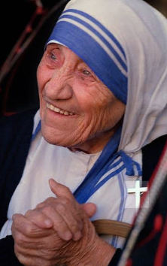
“Not all of us can do
great things. But we can
do small things with
great love.”
- Mother Teresa
The heart behind our service matters
as much as the service itself.
Notes:
Fay

Slide 11
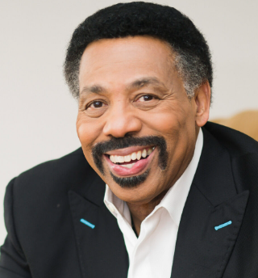
“Servanthood is not about position, it’s about disposition.”
- Tony Evans
You can’t lead people if you don’t love people.
Notes:
Fay

Slide 12
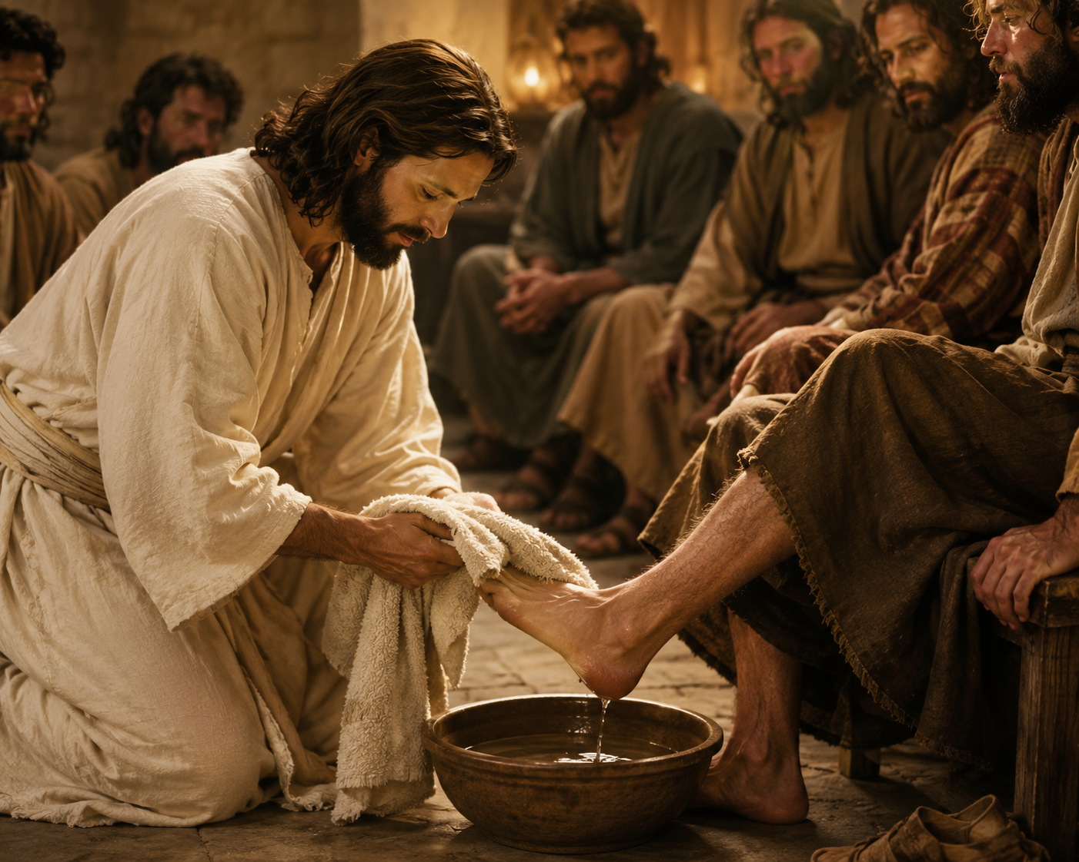
Jesus washed His disciples’ feet, He picked up a towel instead of holding onto His title.
Notes:
Fay

Slide 13
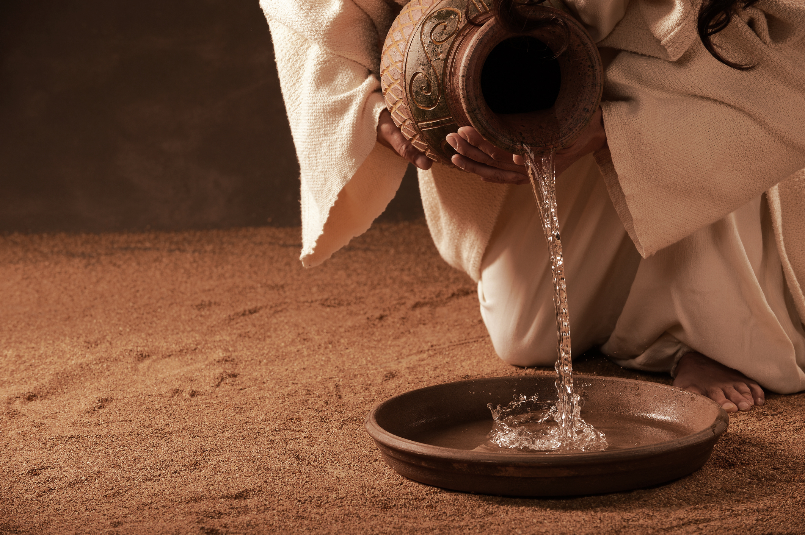
Greatest Model of Servanthood
He got up from the table.
Wrapped a towel around his
waist…
Poured water into a basin
Washed his disciples’ feet
(John 13:1–17)
Notes:
Fay

Slide 14
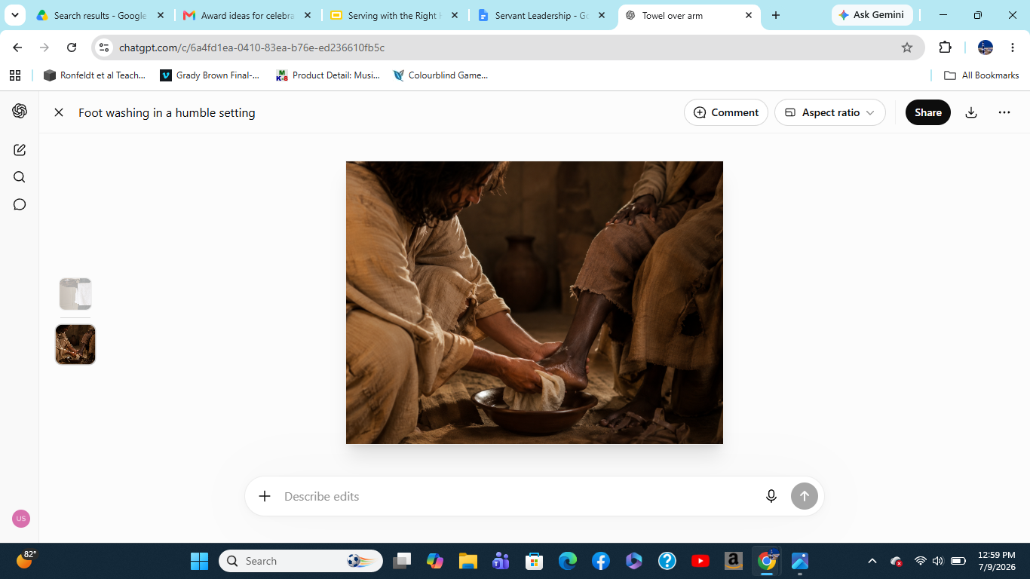
Greatest Model of Servanthood
He served from a place of
authority.
He did what others avoided.
He made service personal.
He connected service to love.
This wasn’t a symbolic gesture in their culture, it was the
lowest servant’s job, reserved for those with no status.
Notes:
Fay

Slide 15
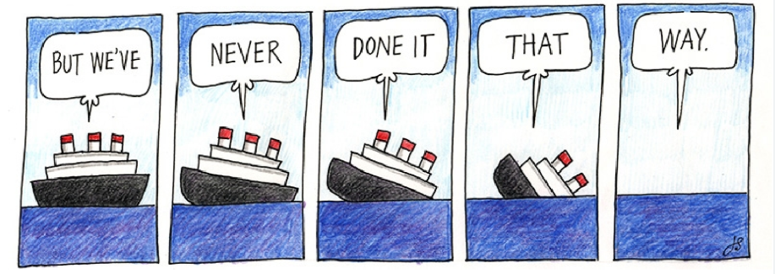
What are we Committed to?
Over time it’s possible to become more committed to:
the ministry
the schedule
the organization
the traditions
than we are to Christ Himself.
Notes:
Fay

Slide 16
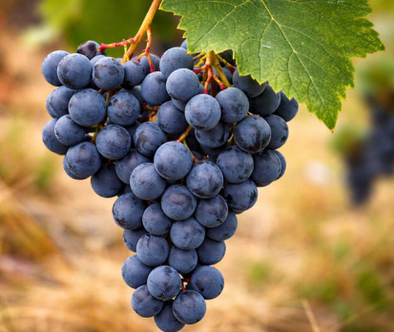
Keeping Christ at the Center
Yes, I am the Vine; you are the branches. Whoever lives in me and I in him shall produce a large crop of fruit. For apart from me you can’t do a thing.
John 15:5 (TLB)
Notes:
Fay

Slide 17
What happens when we begin serving for Kairos instead of serving
from our relationship
with Christ?
Notes:
Fay

Slide 18
The Hidden Danger of Recognition
Sometimes our flesh wants:
appreciation
influence
position
recognition
Most of us would never admit it, but all of us battle it.
When you do good deeds, don’t try to show off. If you do, you won’t get a reward from your Father in heaven.
Matthew 6:1 (CEV)
Notes:
Michael

Slide 19
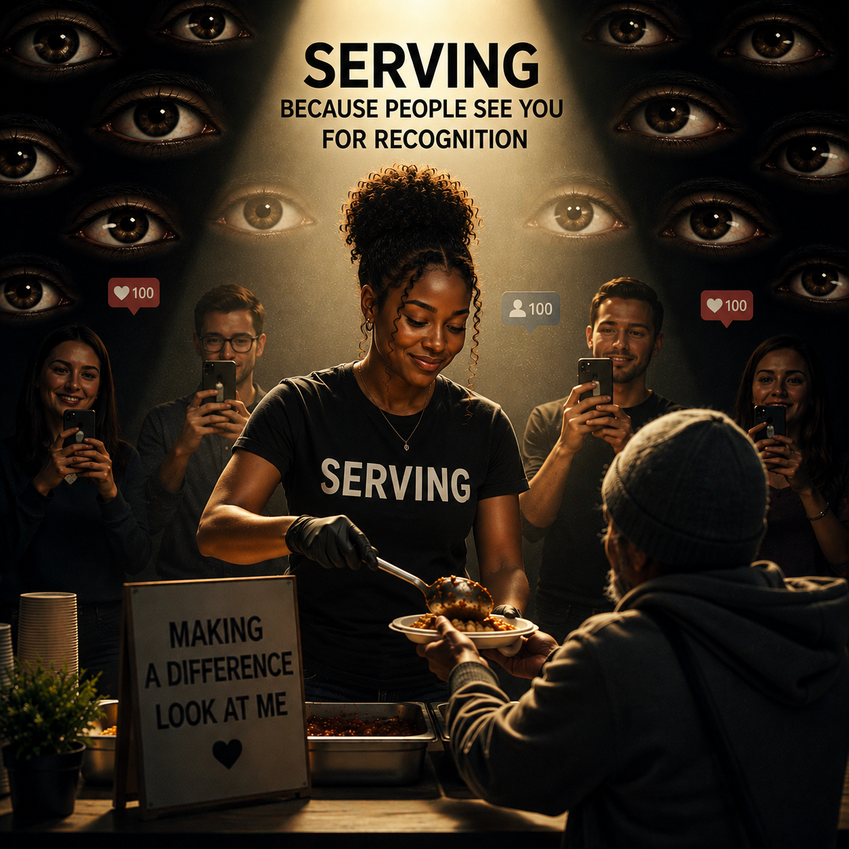
Would I still serve
if nobody
knew I did it?
Notes:
Michael

Slide 20
Serving From Humility
Ego Says:
My way
My idea
My team
My weekend
Humility Says:
How can I help?
How can I support?
What is best for the ministry?
Notes:
Michael

Slide 21
Jesus Emptied Himself
Let nothing be done through selfish ambition or conceit, but in lowliness of mind let each esteem others better than Himself. Let each of you look out not only for his own interests, but also for the interests of others. Let this mind be in you which was also in Christ Jesus, who, being in the form of God,
Notes:
Michael

Slide 22
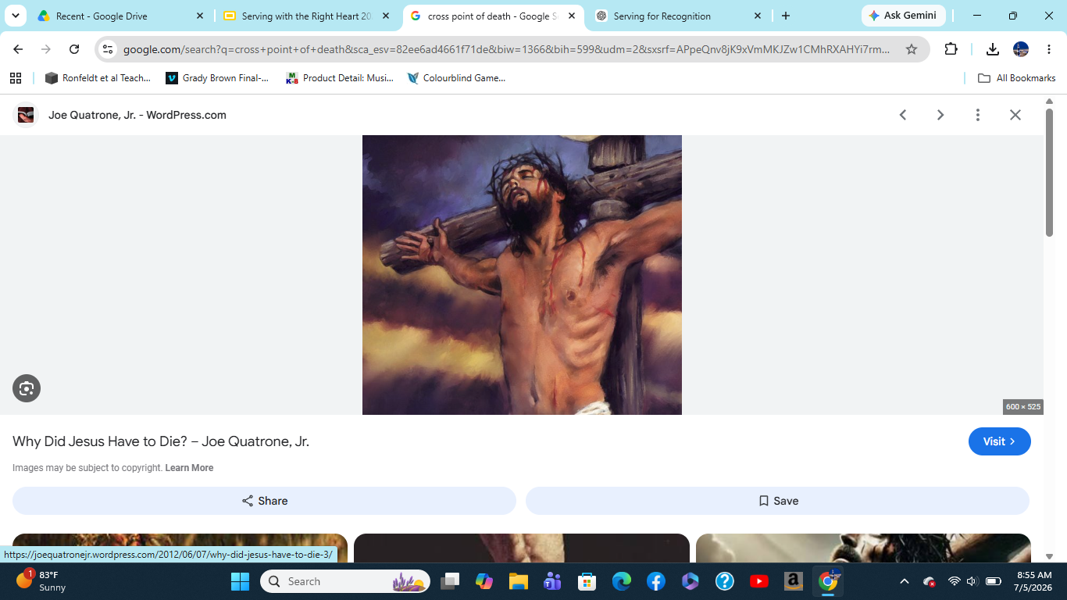
Jesus Emptied Himself
did not consider it robbery to be equal with God, but made Himself of no reputation, taking the form of a bondservant, and coming in the
likeness of men. And being found in appearance as a man, He humbled Himself and became obedient to
the point of death,
even the death of the cross.
Philippians 2:3-8 (NKJV)
Notes:
Michael

Slide 23
Where (how) do I
struggle most
when things
don’t go my way?
Notes:
Michael

Slide 24
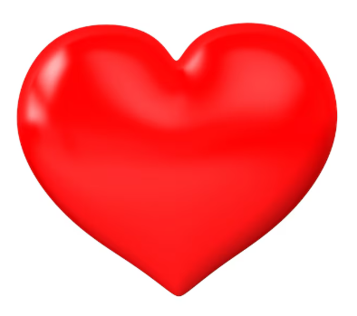
Finishing Well
After years of service, the danger isn’t failure, it’s:
burnout
cynicism
frustration
losing joy
control
complacency
And let us not grow weary while doing good, for in due season we shall reap if we do not lose heart. -
Galatians 6:9 (NKJV)
Notes:
Fay

Slide 25
How do we
protect our hearts
so we can continue
serving faithfully
for years to come?
Notes:
Fay

Slide 26
Suggestions
Daily prayer
Scripture
Sabbath/rest
3 weekends on and 1 weekend off
Accountability
Staying connected to the mission
Notes:
Fay

Slide 27
Heart Check
What first drew me to Kairos?
What currently gives me joy in ministry?
What currently frustrates me?
What might God be inviting me to surrender?
Notes:
Michael

Slide 28
Scenarios
A team member shares that they have always been at the table and they don’t want to serve in the kitchen.
A team member shares that they don’t feel a part of the weekend and feel isolated being a table servant.
A team member shares that they have a powerful story and don’t understand why they weren’t asked to do a talk.
A team member shares that they don’t care for the food that will be served for dinner.
Notes:
Fay

Slide 29
Scenarios
5. A team member shares that they don’t understand why people didn’t clap after her talk and that she didn’t receive enough compliments.
6. A team member continues to tell long personal stories at the table.
7. A team member inserts themselves in poster creating because they are jealous of another family’s posters.
8. A team member doesn’t follow the leader’s directions because that is not the way things have traditionally been done.
Notes:
Fay

Slide 30
“Lord, help me serve not for _________ but for You.”
“This year I want to serve with a heart that is __________.”
Notes:
Michael

Slide 31
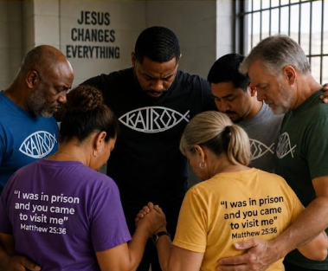
Prayer
Notes:
Fay

